Slide 1
Session 7 -Custom Tags
Custom Tags
<number>/14

Slide 2
Objectives
Tag Libraries
The Custom Tag Development Process
Hunting the Tag
Custom Tag Example
JSTL (read at home)
Tag Interfaces and Classes in javax.servlet.jsp.tagext
The “Classic” Custom Tag Event Model
Tags and Implicit Variables
Custom Tags
<number>/14

Slide 3
Tag Extension Mechanism
Enables creation of custom tags
Java code can be avoided using custom tags
The different terminologies related to tag extension mechanism are:
  Tag library
  TLD
  Custom action
  Custom
Custom Tags
<number>/14

Slide 4
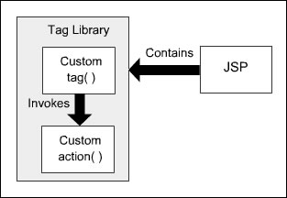
Tag extension mechanism..
Tag library is a collection of custom actions and tags
Custom tag encapsulates complex recurring code.
Custom tag invokes a custom action
Custom Tags
<number>/14

Slide 5
Custom Tags
Separates the work profiles of Web designers and developers
Custom tags can be reused
Written using XML syntax
The different types of custom tags are:
  Empty tag
  Tag with attributes
  Body tags
Custom Tags
<number>/14

Slide 6
Custom Tags…
The function of the tag can be customized using the attributes in the custom tags
TLD file contains the details of the tag attributes
Custom tag body can include static text, HTML, and JSP elements like scriptlets, between the start and the end tag.
Custom Tags
<number>/14

Slide 7
The Custom Tag Development Process
There are four essential steps to writing a custom tag for use in your JavaServer Pages:
  Writing a Java class called a tag handler
  Defining the tag within a tag library definition (TLD) file.
  Providing details of where to find the TLD file in the deployment descriptor, web.xml
  Referencing the TLD file in your JSP page source and using the tags from it.
Custom Tags
<number>/14

Slide 8
Hunting the Tag
taglib uri declaration in
JSP page maps to <taglib-uri> in deployment descriptor.
JSP Document
<html>
<body>
<%@taglib uri="test_taglib" prefix="myTag"%>
<myTag:showDate/>
</body>
</html>
Web Deployment Descriptor
<web-app>
<taglib>
<taglib-uri> test_taglib </taglib-uri>
<taglib-location>
/WEB-INF/myown-taglib.tld
</taglib-location>
</taglib>
</web-app>
START HERE: tag used in JSP page.
Tag Library Descriptor
<taglib>
<tag>
<name>showDate</name>
<tagclass>examples.ShowDateTag</tagclass>
<bodycontent>EMPTY</bodycontent>
</tag>
</taglib>
<taglib-location> in
deployment descriptor maps to
the real tag library descriptor file.
Tag Handler Class
1000001000000010101010
0000101010100000010010
1000011111111000000000
1000001000000010101010
0000101010100000010010
1000011111111000000000
Finally:
<tag-class> in the TLD maps to a tag handler class.
Custom Tags
<number>/14

Slide 9
Custom Tag Example
Demo\CusTags
Custom Tags
<number>/14

Slide 10
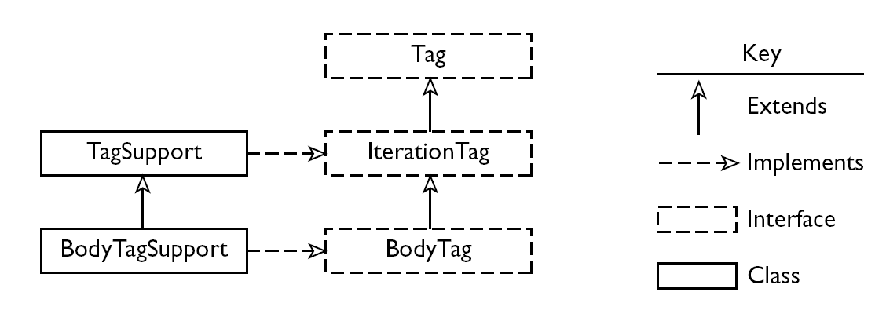
Tag Interfaces and Classes in javax.servlet.jsp.tagext
Tag Interfaces and Classes in javax.servlet.jsp.tagext
Custom Tags
<number>/14

Slide 11
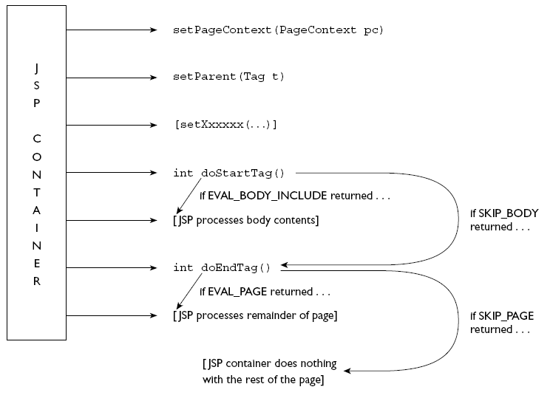
The “Classic” Custom Tag Event Model
JSP container processing one occurrence of a tag implementing the Tag Interface in one JSP page.
Custom Tags
<number>/14

Slide 12
Tags and Implicit Variables
Using the PageContext API we can write tag handler code to access the JSP implicit variables and access web application attributes.
Custom Tags
<number>/14

Slide 13
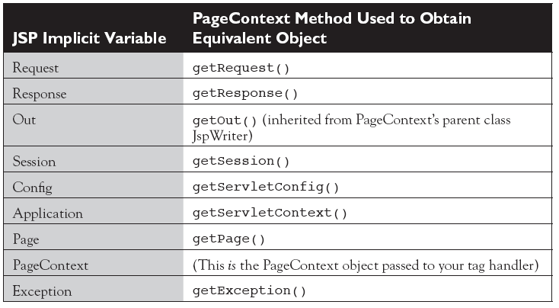
Tags and Implicit Variables…
Custom Tags
<number>/14

Slide 14
Summary
Tag Libraries
The Custom Tag Development Process
Hunting the Tag
Custom Tag Example
Tag Interfaces and Classes in javax.servlet.jsp.tagext
The “Classic” Custom Tag Event Model
Tags and Implicit Variables
Q&A
Custom Tags
<number>/14

